Slide 1
Wireless Communications:
Principles and Practice
2nd Edition
T.S. Rappaport
Chapter 8: Speech Coding

Slide 2
Digital Equalization, Rake Receivers

Slide 3
Speech Coding

Slide 4
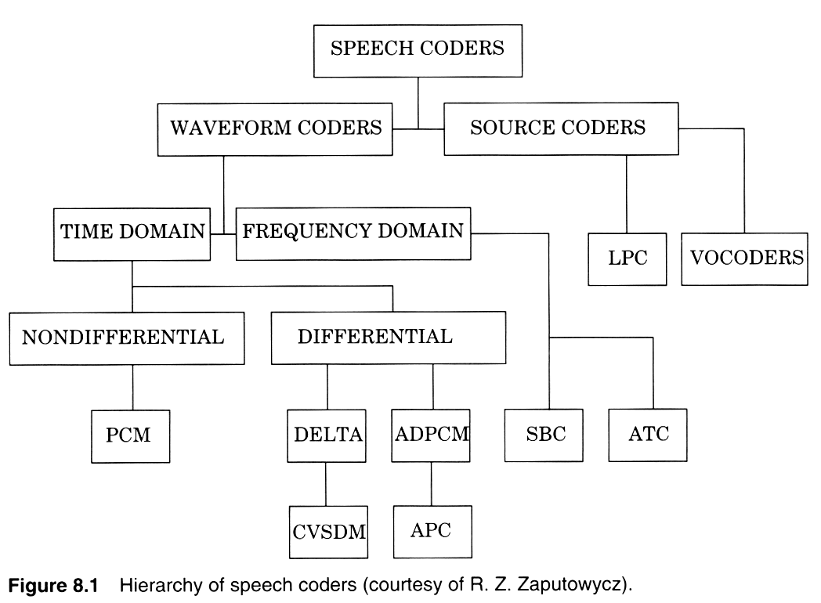

Slide 5
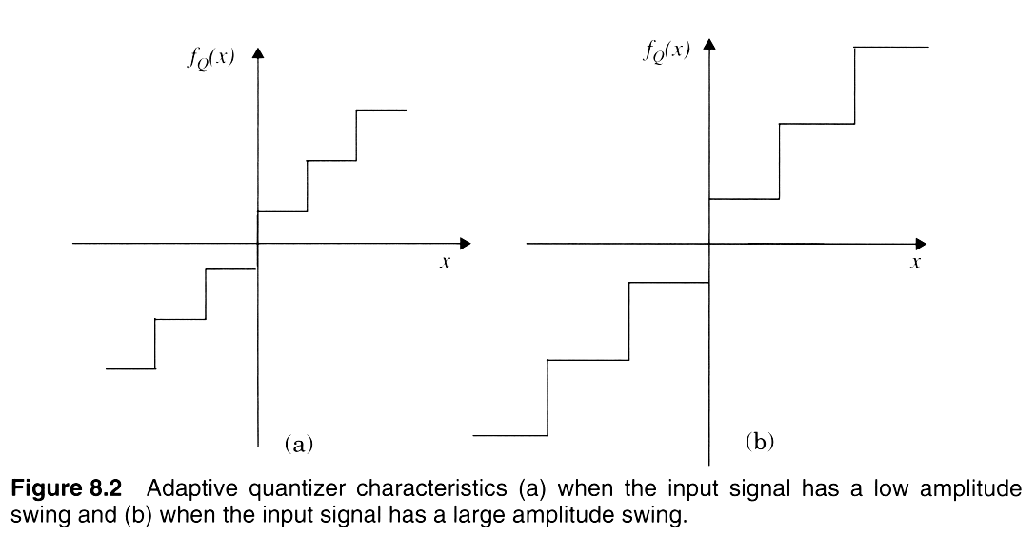
Notes:
Fig. 3.2

Slide 6
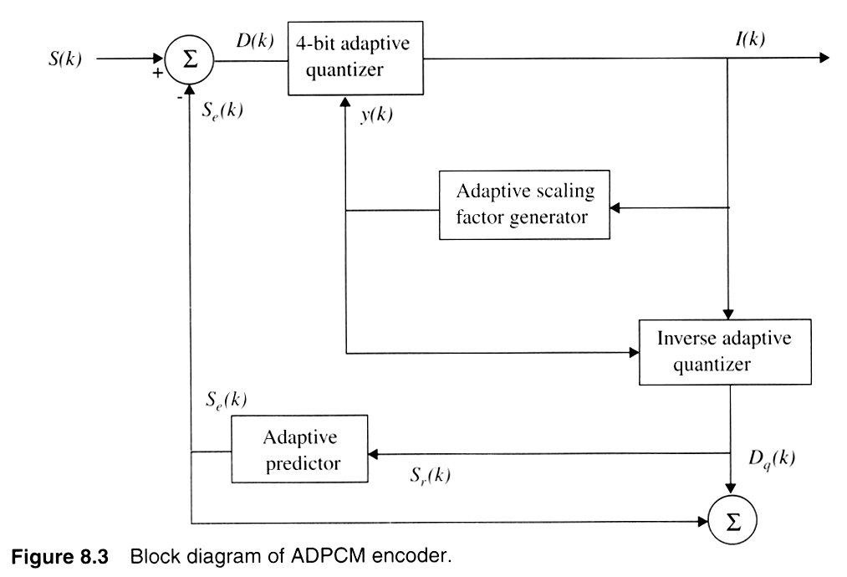

Slide 7
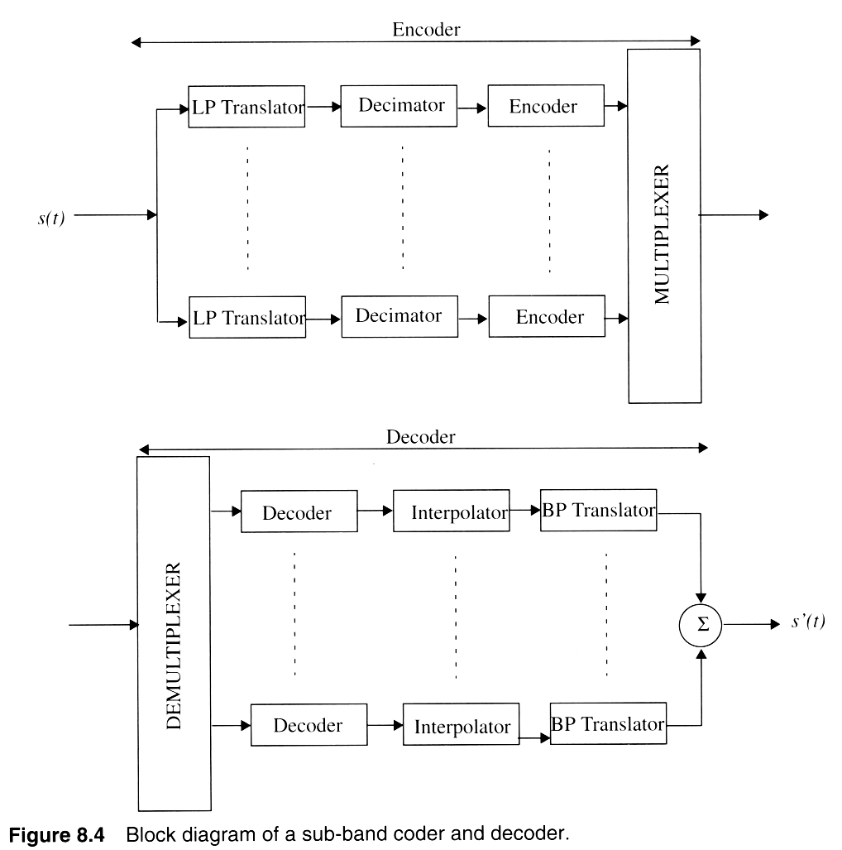
Notes:
Fig. 2.3

Slide 8
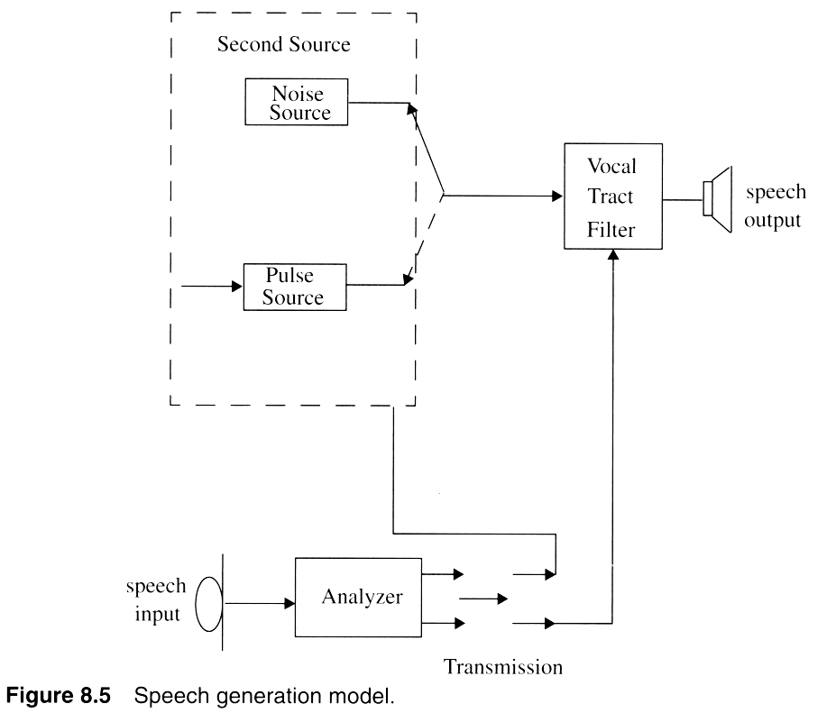

Slide 9
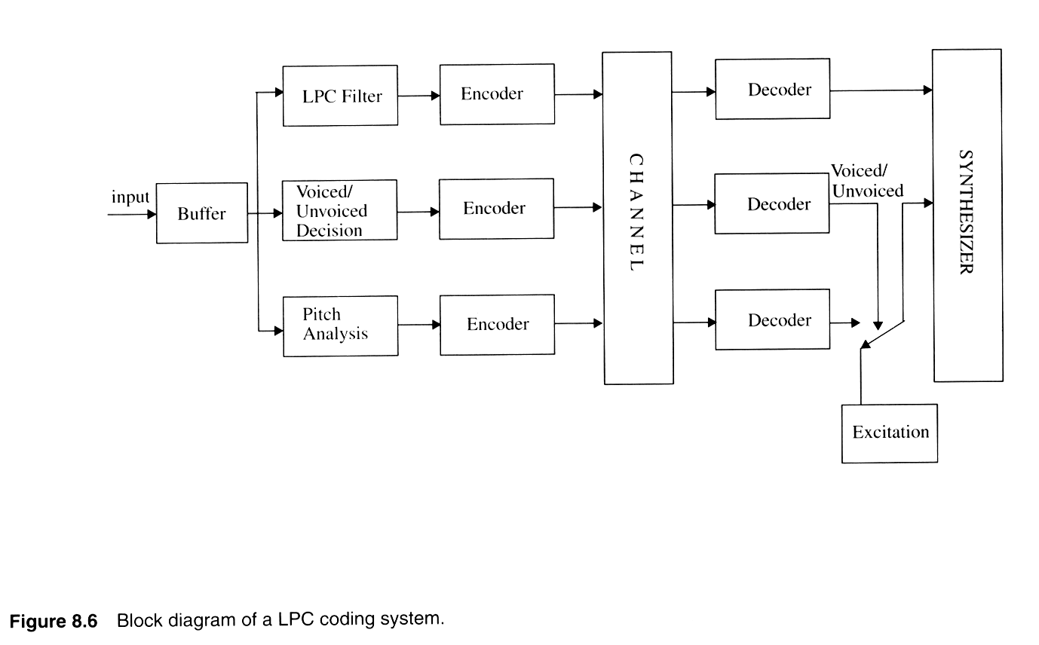

Slide 10
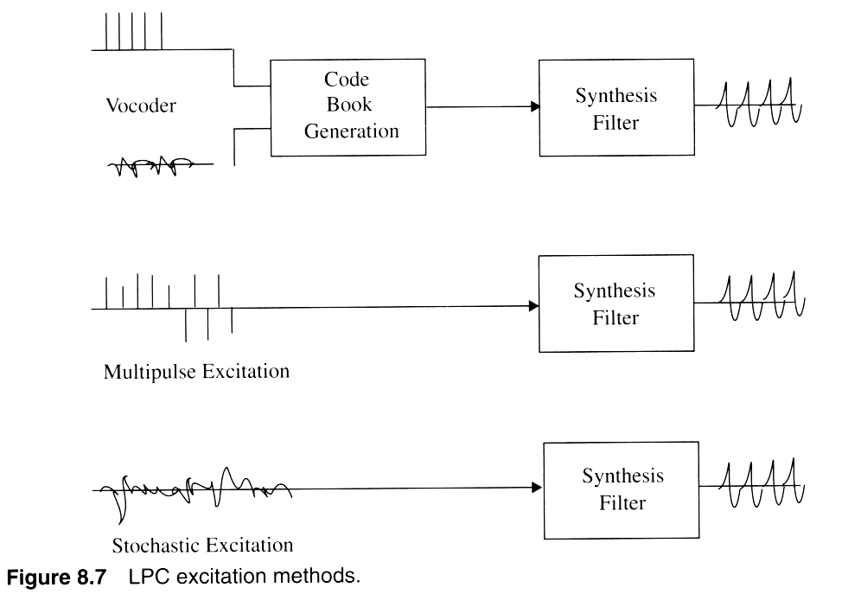
Notes:
Fig. 2.4

Slide 11
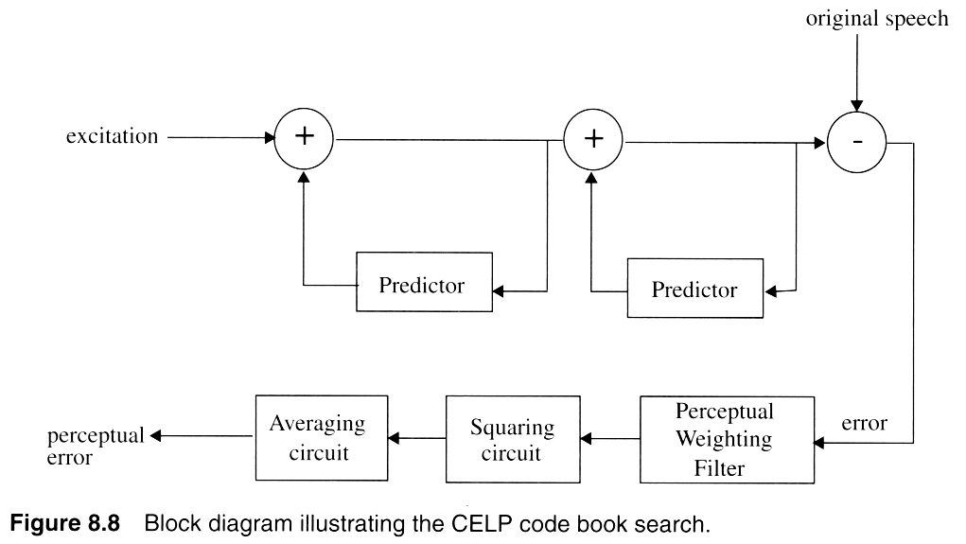
Notes:
Fig. 2.5

Slide 12
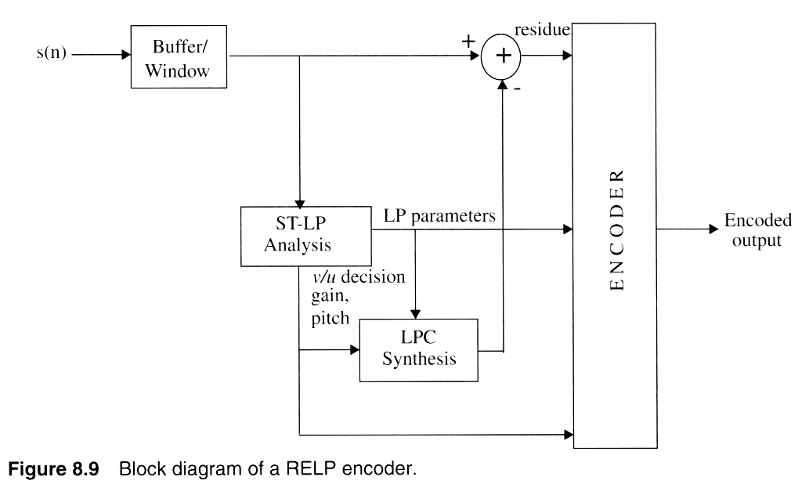
Notes:
Fig. 2.6

Slide 13
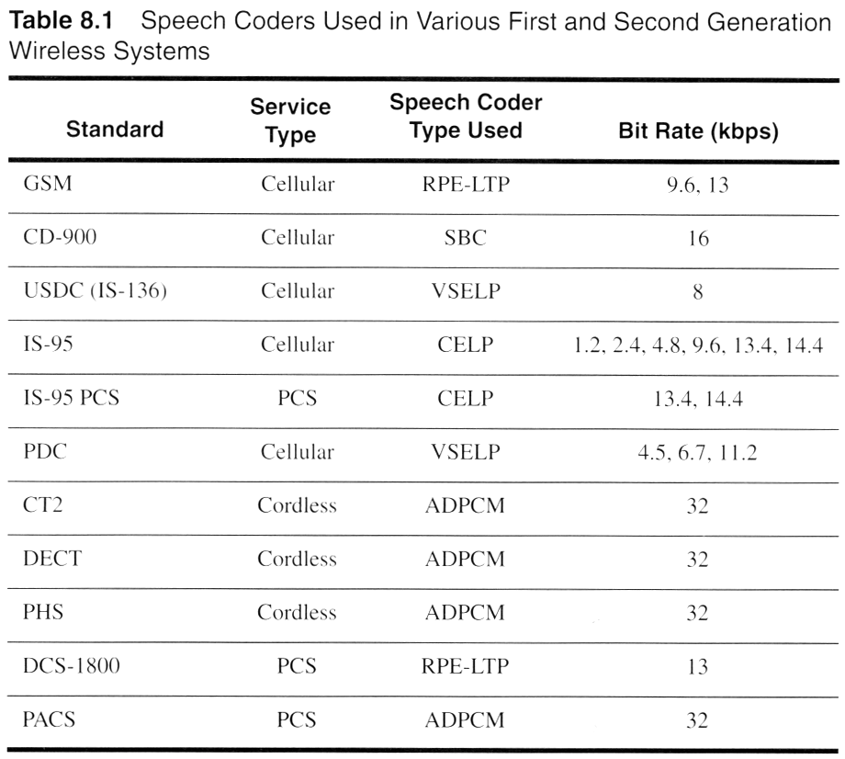
Notes:
Fig. 2.9

Slide 14
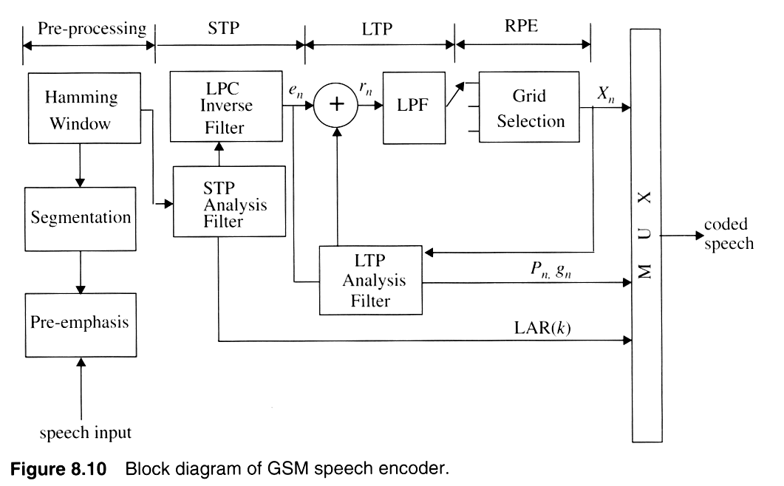
Notes:
Fig. 2.7

Slide 15
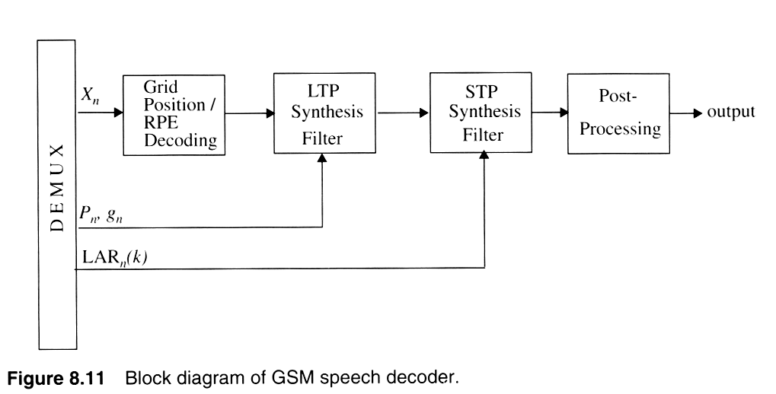
Notes:
Fig. 2.16

Slide 16
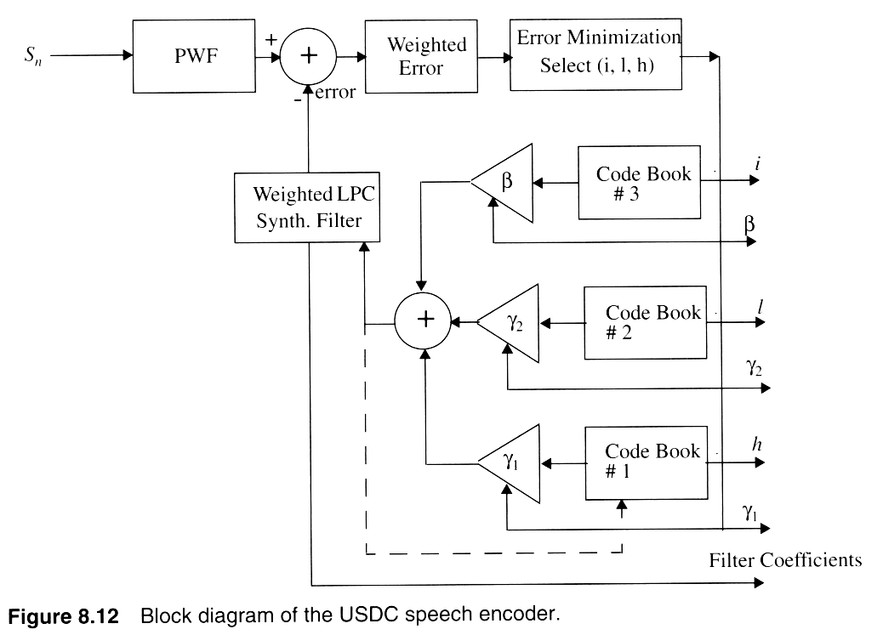
Notes:
Fig. 2.8

Slide 17
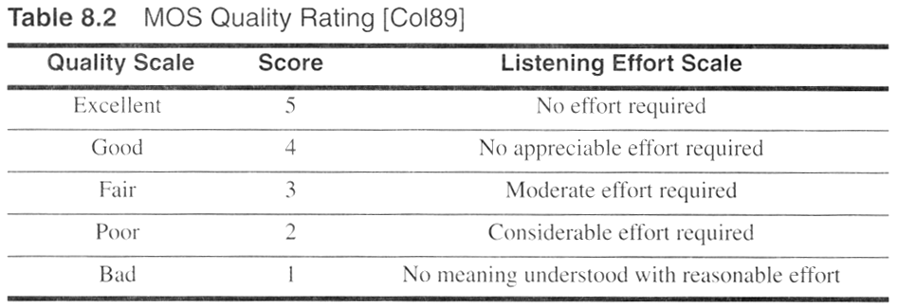
Notes:
Fig. 2.10

Slide 18
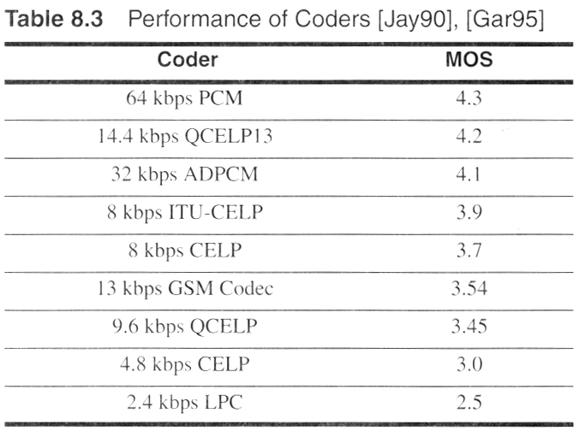
Notes:
Fig. 2.11

